Slide 1
Scrum-Agile Approach
By: Kevin Akers

Slide 2
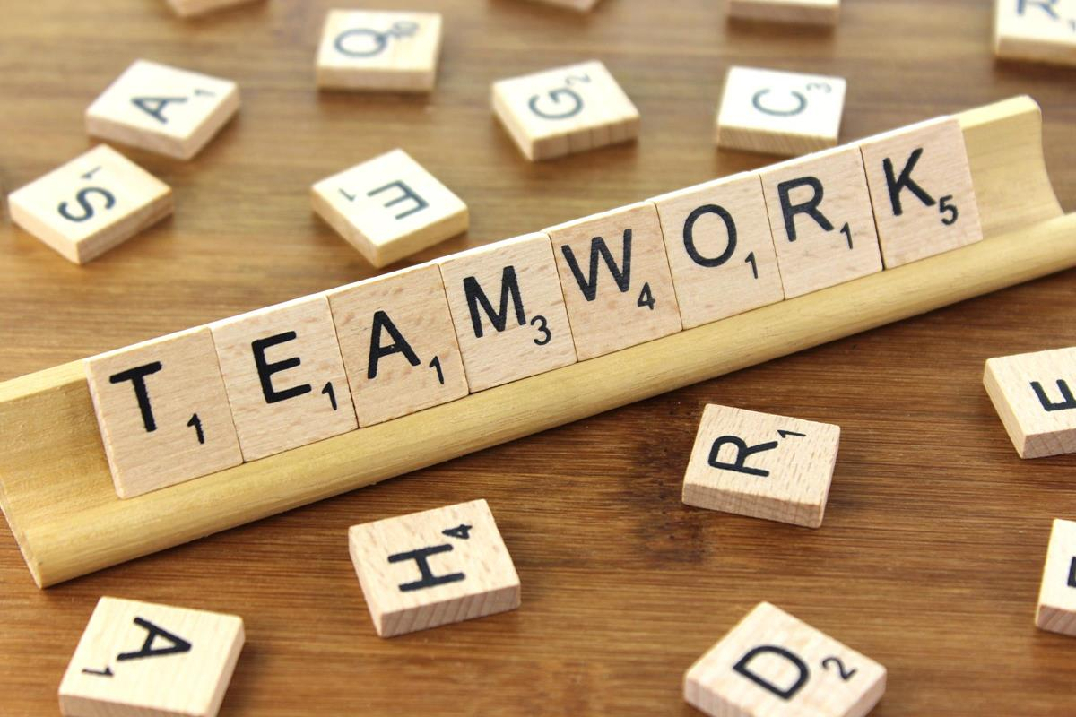
Scrum-Agile Team Roles
Scrum Master
Assembles the team to fill other roles
Communication bridge between the customer and the team
Product Owner
Helps facilitate customer ask(s) to the development team
Communication bridge between scrum master and the development team
Developer
Develops product based on ask(s) from customer and product owner
Tester
Test what the development team produces
Reports bugs back to the developers
This Photo by Unknown Author is licensed under CC BY-SA **Photo 1

Slide 3
Software Development Life Cycle
Project Planning
The scrum master and the product owner speak with the customer to see what they want
Gathering Requirements & Analysis
The whole team then works together to produce a plan and a time frame for the work
Design
The product owner and the developers work together to determine the design of the product.
Coding or Implementation
The developers then write the code and develop the product
The developers adjust the code based on new asks and feedback from the testers
Testing
Testers then test the product
Provide feedback to the developers
Deployment
Final product is deployed to the customer for use
Maintenance
The team upholds maintenance as the product is used by the customer
How the phases work in an agile approach
(7 Stages of SDLC: How to keep Development Teams Running)

Slide 4

Waterfall Vs. agile approach
If the waterfall approach would have been used instead:
Different parts of development would not be done simultaneously
Communication is more likely to come at the end of each stage rather then through development
Customer asks are harder to accommodate for
During the SNHU travel project, the customer had asked for different changes after the development started
Development would have had to stop and start over if the waterfall approach was taken

Slide 5

Choosing Waterfall vs Agile approach
Factors to consider when choosing between a waterfall approach and an agile approach
What is the product your customers are looking to develop?
Is the customer asking for something their customers could use, they could use or someone else could use?
The customer asked for a niche travel booking site, seemed to need multiple functionality with different categories, an agile approach is best here.
What resources do you have to help develop the product?
Do you have enough employees to use an agile approach?
The customer asked our company to help with the product, which our company consisted of a few small teams
What time-frame is the customer looking to have the product complete?
If they want it right away and it is a small ask, then a waterfall approach might work
The customer asked for multiple small asks on a larger product, thus an agile approach was more effective

Slide 6
Refrernces
Photo 1, by Unknown Author is licensed under CC BY-SA
“7 Stages of SDLC: How to Keep Development Teams Running.” 21st March, 2019. https://www.betsol.com/blog/7-stages-of-sdlc-how-to-keep-development-teams-running/.

